Slide 1


From Zero to Hero
Creating a Low Risk, High Reward
Real Estate Investment Strategy
Joe McHugh and Joe Buzzelli
May 8, 2020

Slide 2

The Joes are poor and plan to make money in real estate
J&J
Joe McHugh and Joe Buzzelli plan to borrow money in order to invest in real estate by starting J&J Real Estate
The J&J investment strategy is a to identify zip codes in the United States where investments minimize risk and maximize returns
After identifying the top three zip codes, we forecast future values of real estate in order to select our first investments in real estate

Slide 3
Assumptions and data sources
J&J
Data sources
Monthly Zillow housing values from 04/01/1996 to 04/01/2018
Null values were backfilled
Assumptions
Only focusing on residential real estate
Assuming that access to credit are generally equal across all zip codes
Real estate trends changed after the housing crisis (2006-2011) so this analysis focuses on real estate values from 2011 through 2018

Slide 4
J&J identified the top three zip codes for initial investment
J&J
J&J’s analysis concluded that the following zip codes pose the least risk and are initial targets for investment
Zip Code | City, State | Zillow Home Value Index (4/2018)
33974 | Lehigh Acres, FL | $164,700
47353 | Liberty, IN | $88,200
67860 | Larkin, KS | $142,000

Slide 5
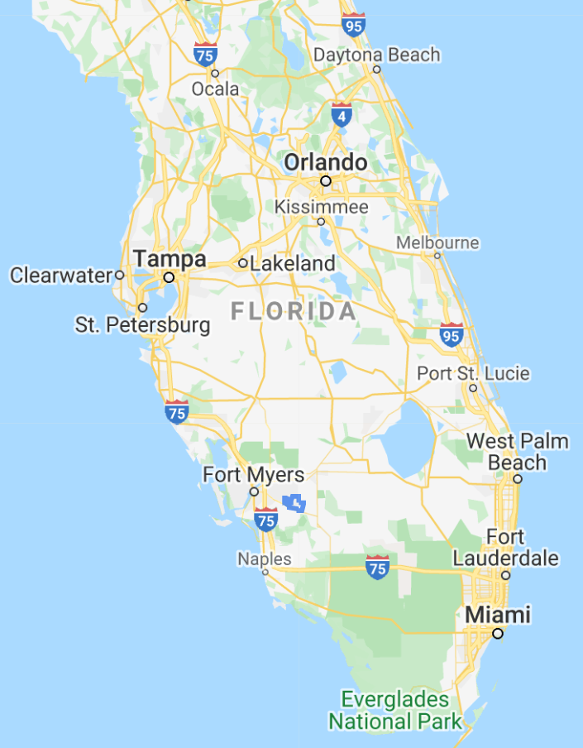
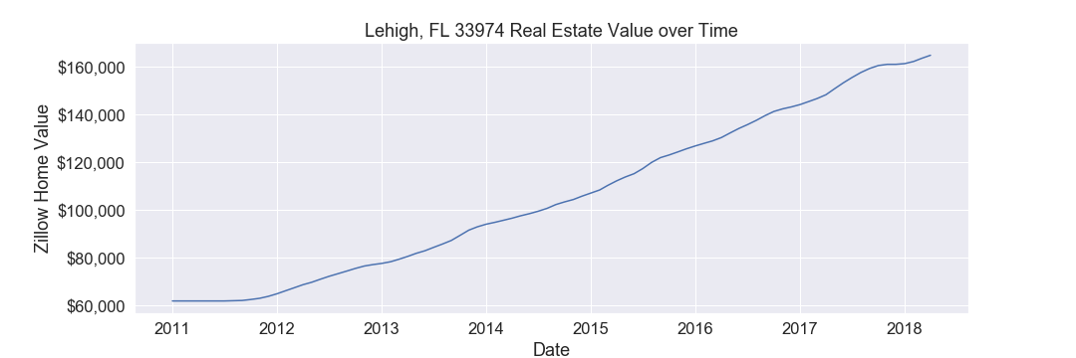
Real estate trends in Lehigh, FL 33974
J&J

Slide 6
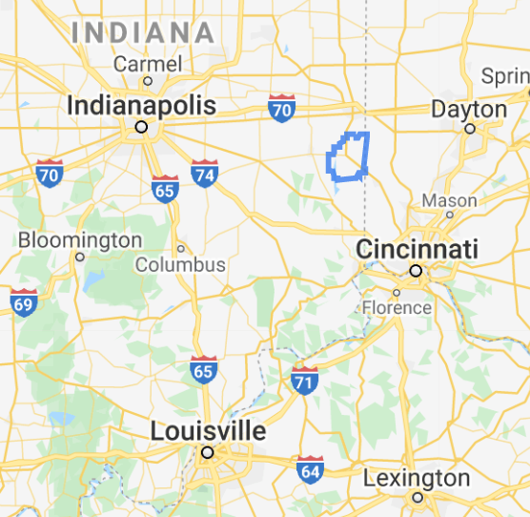
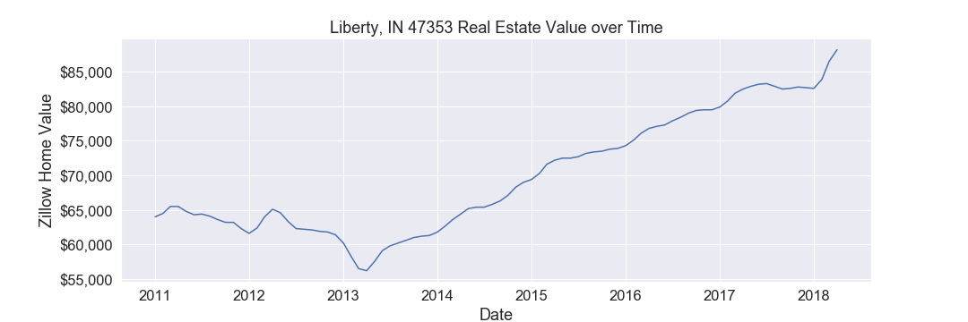
Real estate trends in Liberty, IN 47353
J&J

Slide 7
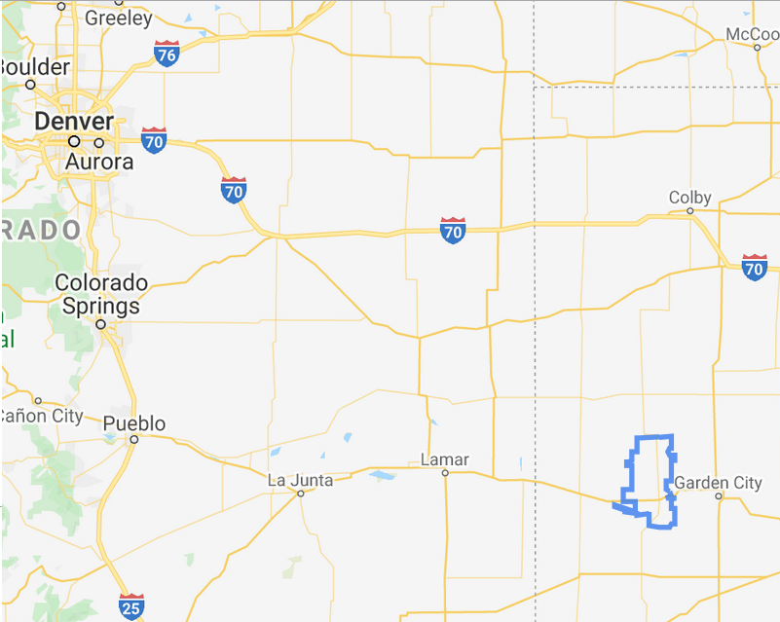
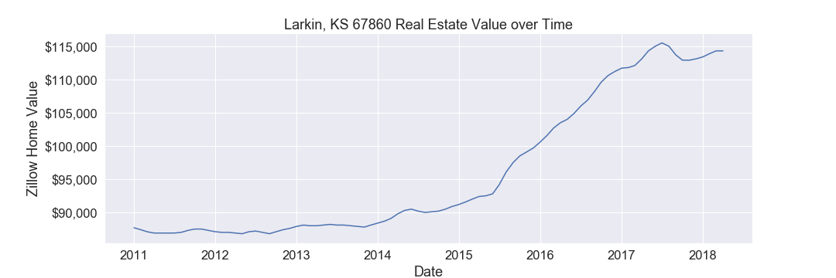
Real estate trends in Larkin, KS 67860
J&J

Slide 8
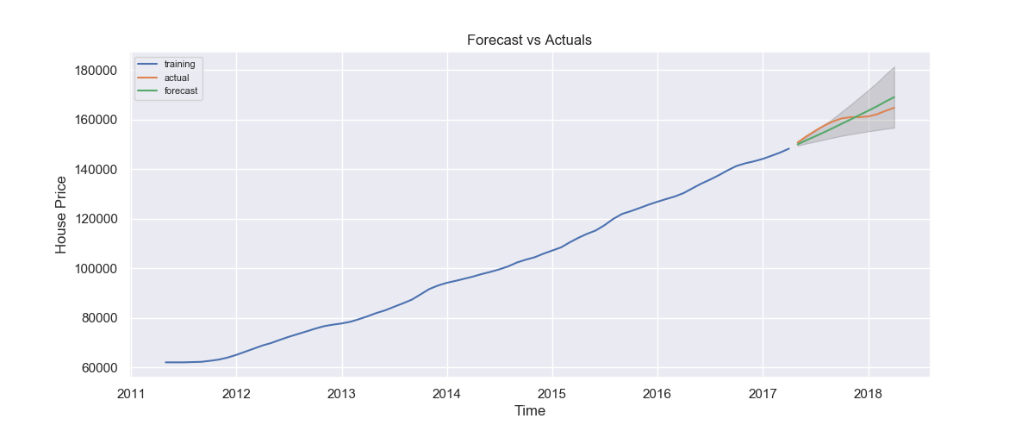
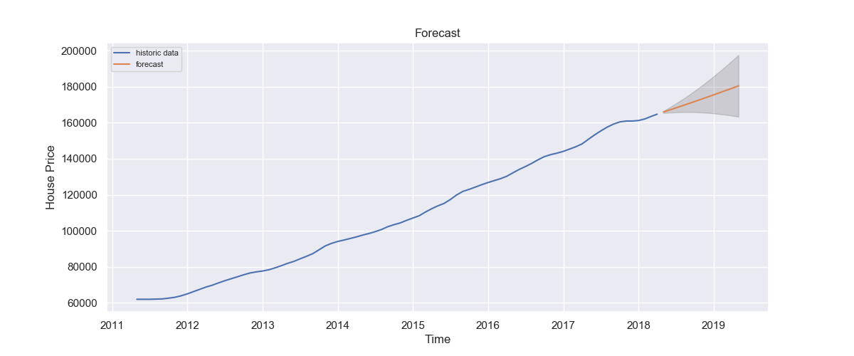
Forecasted real estate values in Lehigh, FL 33974
J&J
Forecasted Annual Growth: 8.38%
Uncertainty Level: 20.8%

Slide 9
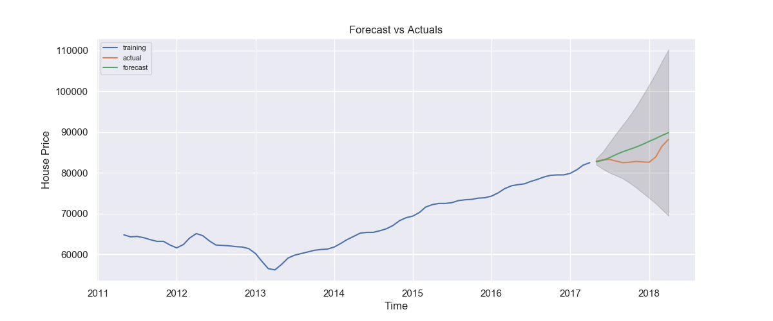
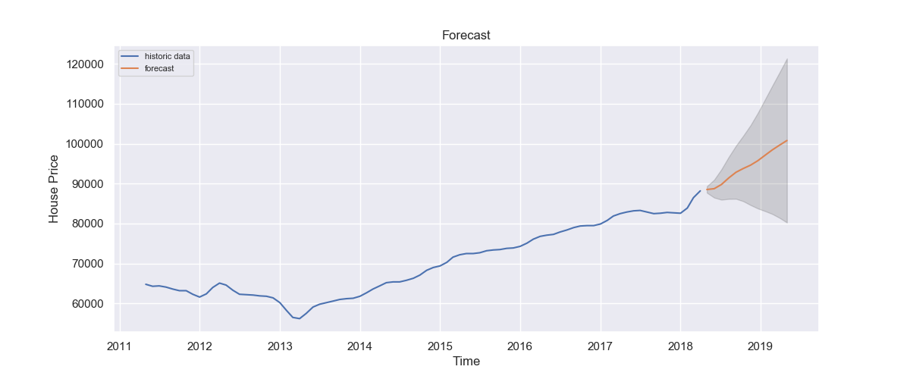
Forecasted real estate values in Liberty, IN 47353
J&J
Forecasted Annual Growth: 12.9%
Uncertainty Level: 46.6%

Slide 10
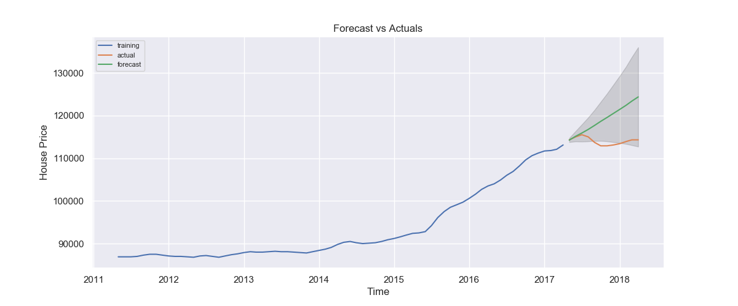
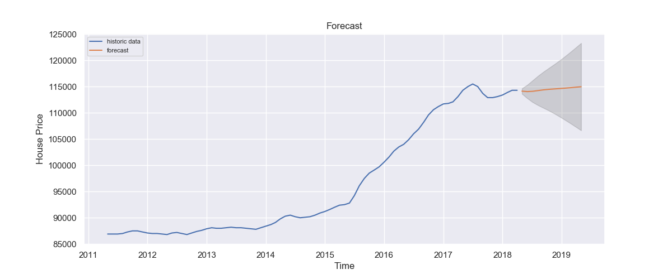
Forecasted real estate values in Larkin, KS 67860
J&J
Forecasted Annual Growth: 0.7%
Uncertainty Level: 14.6%

Slide 11
The Numbers:
J&J
Zipcode | Lehigh, FL | Liberty, IN | Larkin, KS
Forecasted Return | 8.38% | 12.90% | 0.70%
Positive Uncertainty | 20.00% | 37.60% | 7.89%
Negative Uncertainty | 0.80% | 8.00% | 6.69%
Downside Ratio | 23.12 | 4.18 | 1.17
Risk Adjusted Return Score | 9.31 | 1.16 | 0.05
Portfolio Weights | 78.89% | 20.36% | 0.75%
Number Crunch Time
What’s the bottom line?
Implementing a portfolio as specified by J&J, investors can expect a return of
8.49%
over the next 12 months
(Note: The entire real estate market averaged only 6.06% in the past 12 months)

Slide 12
Augment analysis by integrating data pertaining to access to credit per zip code in the U.S.
We recommend that you all invest in J&J today!
Recommendations

Slide 13
Continue to monitor cash flows from portfolio to validate forecast
Assess effect of Covid-19
Implement credit default swap strategy for rapid capital extraction in the even of complete financial meltdown
Next Steps

Slide 14
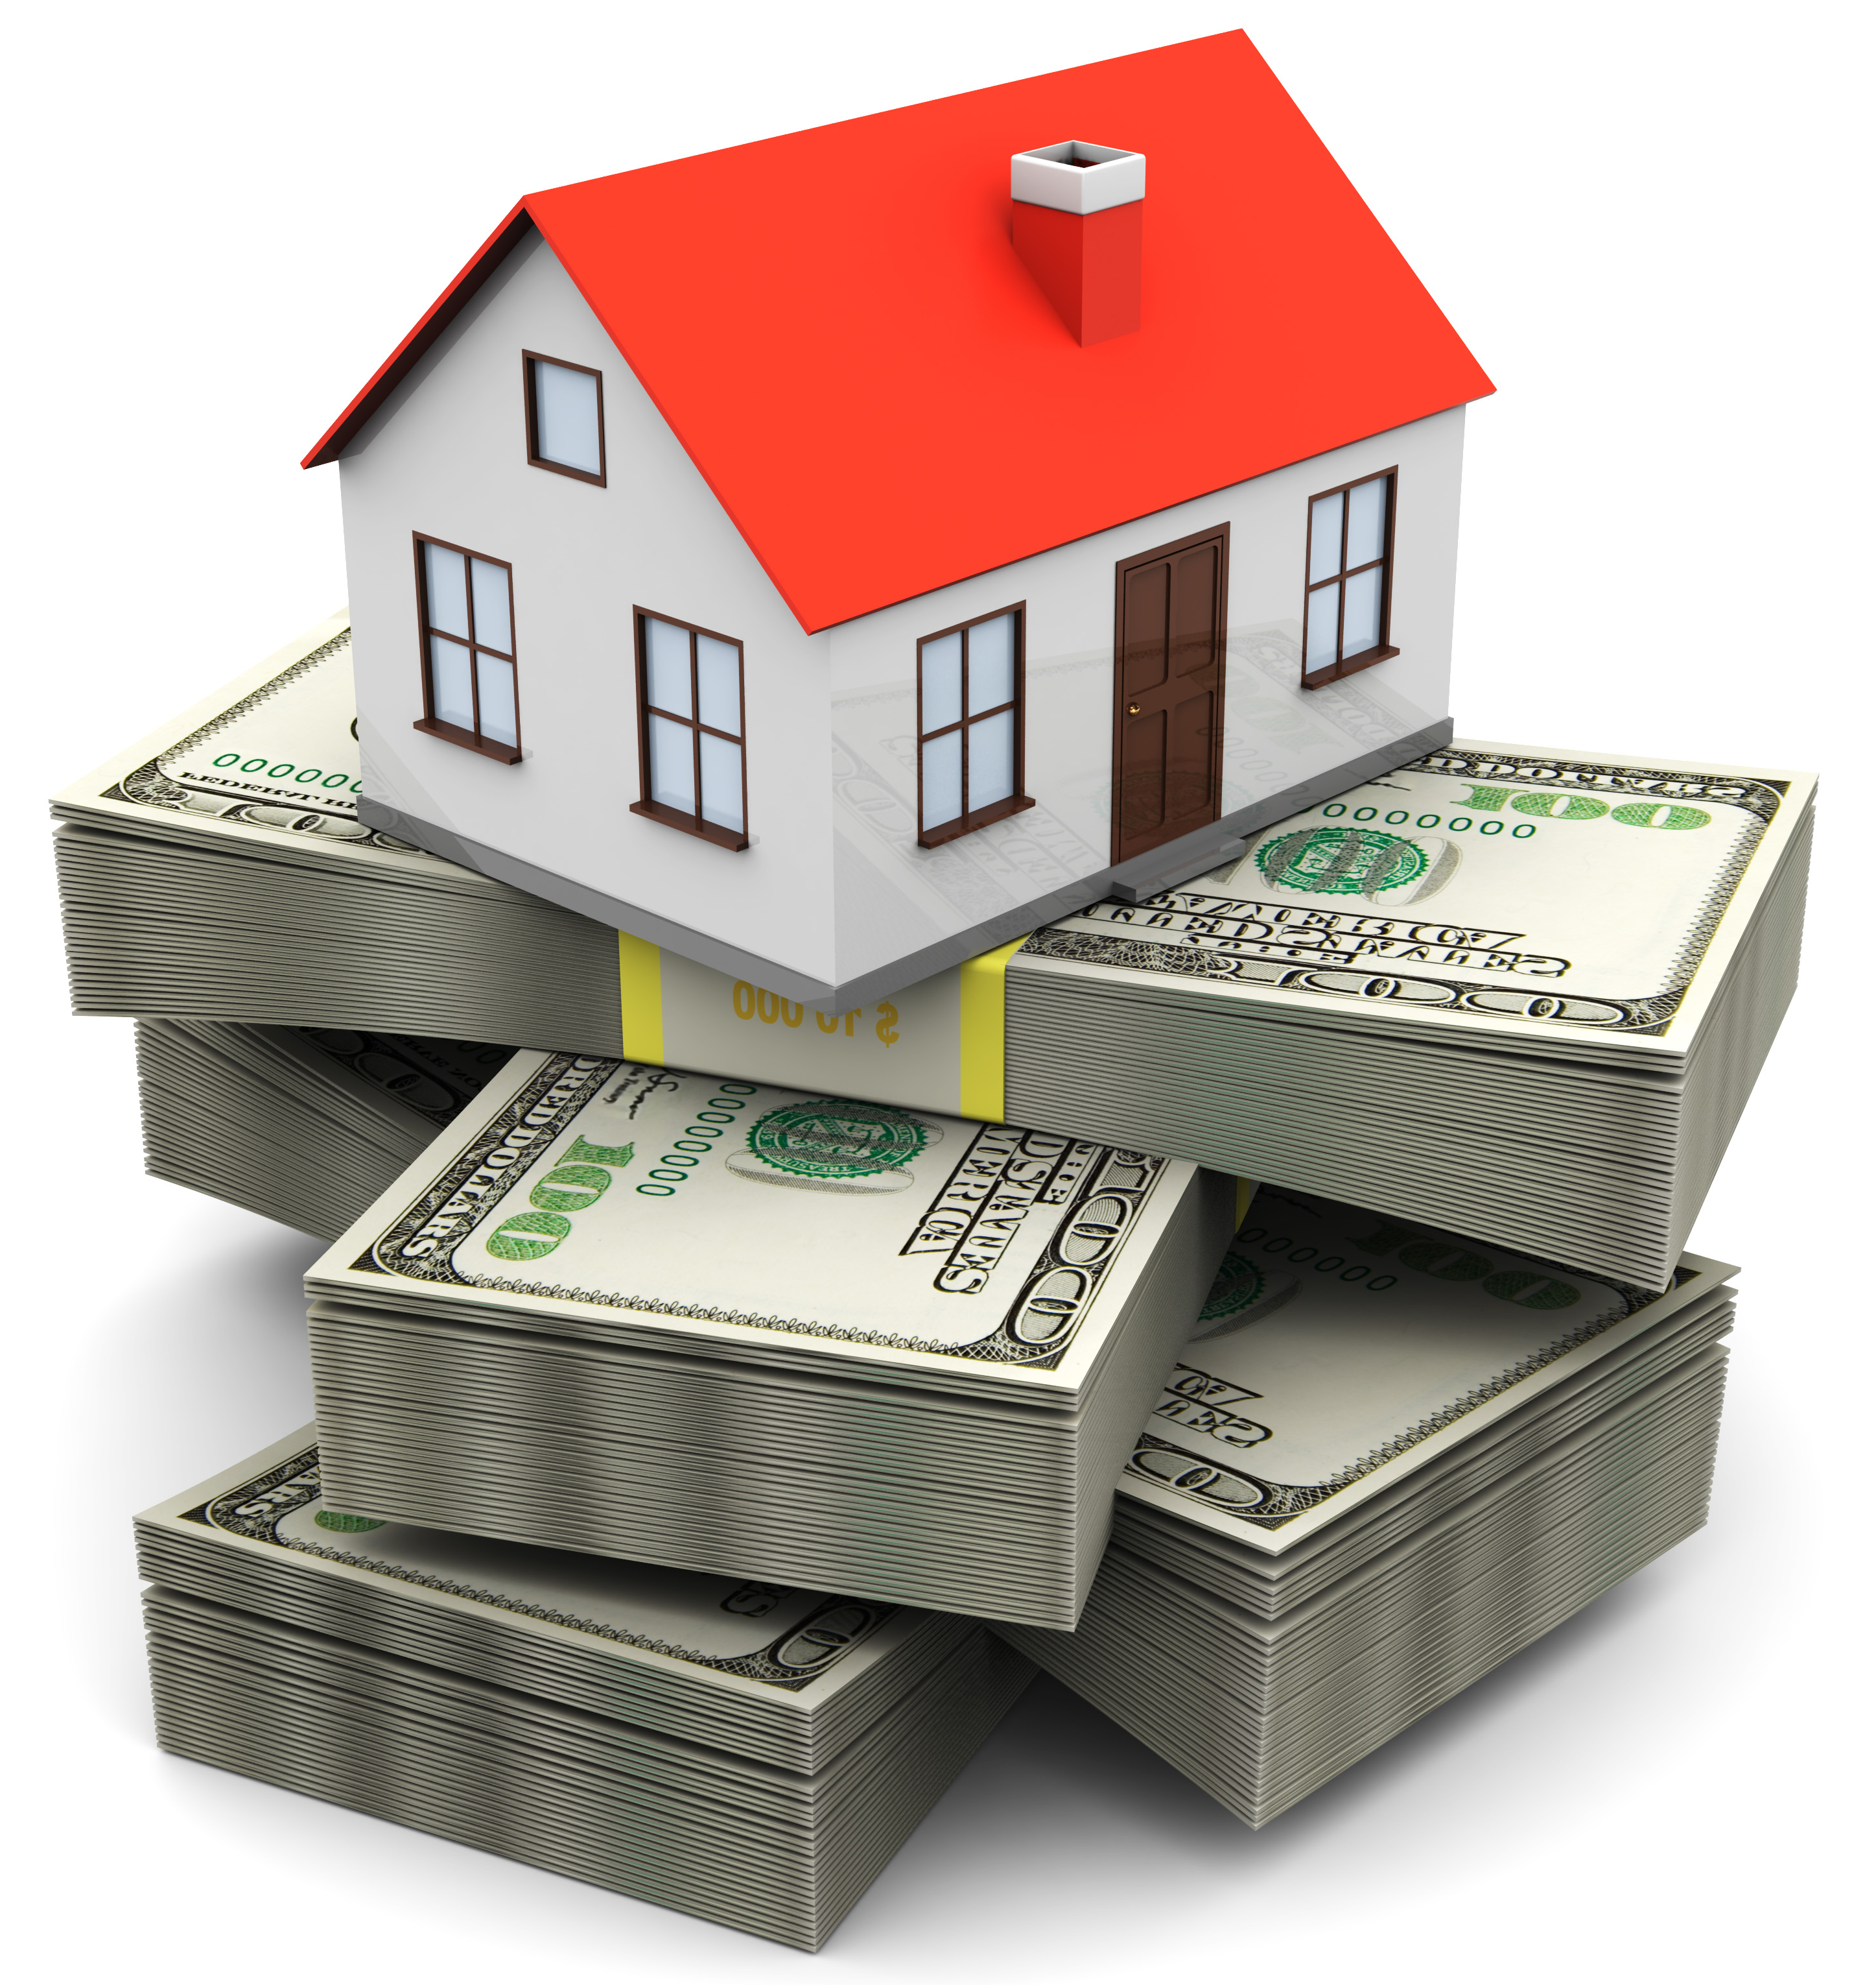
Thank you for your time.
Are there any questions?

